Slide 1

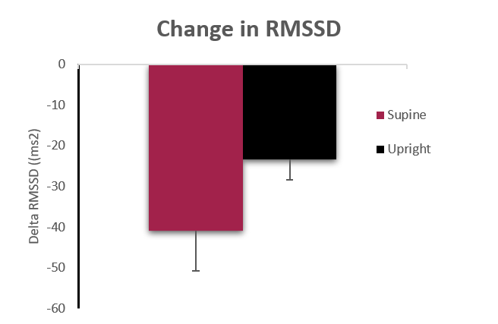
Title
Mary J. Adams, Sally Q. Burns, Desiree A. Davis. Research Mentor: Julia A. Moffitt, PhD
Introduction
Results
Bullets
Bullets
Bullets
Figure 1. The change in RMSSD in response to exercise between the supine and upright groups. Although there was no significant difference between groups, there was a trend toward less of a reduction in RMSSD in the upright posture.
Bullets
Bullets
Bullets
Hypothesis
Conclusions
Hypothesis statement.
Bullets
Bullets
Bullets
Methods
References
Bullets
Bullets
Bullets
Bigger Jr. T, Breithardt G, Cerutti S, et al. Heart rate variability standards of measurement, physiological interpretation, and clinical use. Circulation. 1996; 93:1043–1065
Bernardi L, Salvucci F, Suardi R, Solda PL, Calciati A, Perlini S, Falcone C and Ricciardi L. Evidence for an intrinsic mechanism regulating heart rate variability in the transplanted and the intact heart during submaximal dynamic exercise? Cardiovascular Res. 1990; 24: 969-981
Perini R, Orizio C, Milesi S, Biancardi L, Baselli G, Veicsteinas A. Body position affects the power spectrum of heart rate variability during dynamic exercise. European Journal of Applied Physiology. 1992;66:207-213
Additional primary source.
Additional sources as needed.
Notes:
Need to add something about sudden cardiac death?

